Slide 1

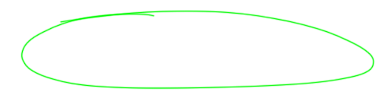
Productivito Productivity App for Students
G.NAVEEN - AIE22115
K.ARHANT - AIE22123

Slide 2
TABLE OF CONTENTS
01.
02.
03.
04.
05.
06.
INTRODUCTION
LITERATURE SURVEY
DESIGN
IMPLEMENTATION
07.
08.
RESULTS
FUTURE SCOPE
DEMO
CONCLUSION

Slide 3





INTRODUCTION
The productivity app is designed to address common challenges faced by students.
The app integrates essential tools like a study planner for tracking study sessions, a to-do list to manage daily tasks, and a habit tracker to promote positive routines.

Slide 4


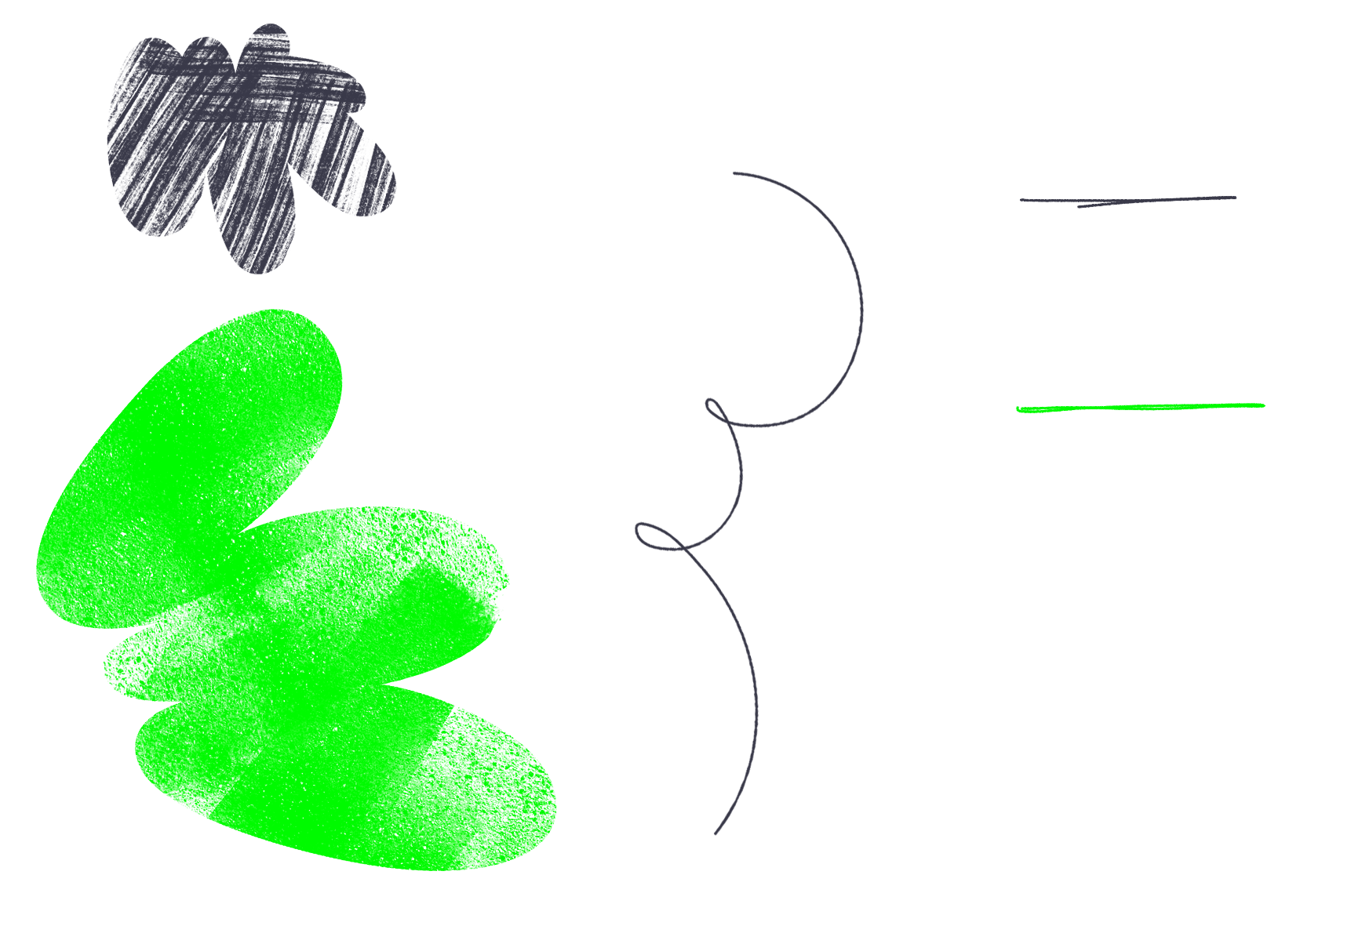
LITERATURE SURVEY
V. Chilamkurthi et al., "Enhancing Field Employee Productivity and Performance with Android Software Solution and Machine Learning-based Predictive Analytic Model"
This paper focuses on improving the productivity and performance of field employees using an Android app integrated with machine learning. It offers features like real-time analytics, AI/ML integration, and customizable reminders. However, it lacks features like a study planner, habit tracker, or gamification, which makes it more suitable for workplace environments rather than student-focused needs.
K. Silva et al., "E-tutor: Comprehensive Student Productivity Management System for Education"
This work is aimed at students and emphasizes task management through tools like a to-do list and customizable reminders. While it covers essential productivity features limiting its scope for holistic productivity improvement.

Slide 5
LITERATURE SURVEY
D. Kavitha et al., "Sparkle- Mobile Application for Real-Time Activity Analysis and Mental Wellness Insights"
This paper targets general users and focuses on activity tracking and wellness. It provides features like personalization, mental wellness tools, and AI/ML integration.
A. Dalvi and I. Siddavatam, "SnoopMe-Interactive Task Scheduler Mobile Application for Students"
Aimed specifically at students, this work revolves around task scheduling and includes a to-do list and gamification features to keep users motivated. It also offer advanced tools like AI/ML integration, real-time analytics,

Slide 6
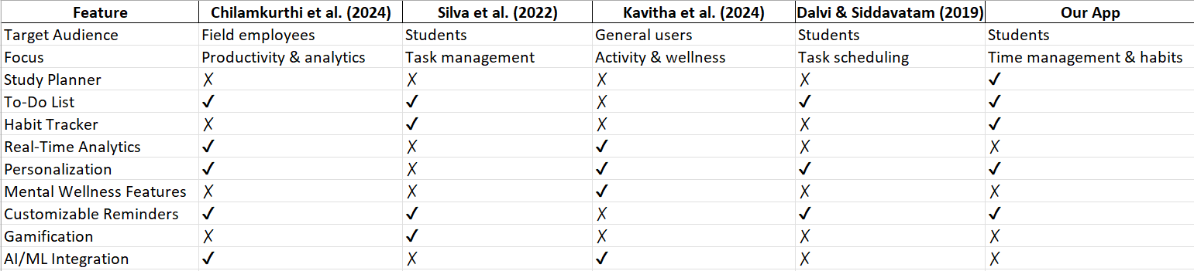
LITERATURE SURVEY COMPARISON TABLE

Slide 7
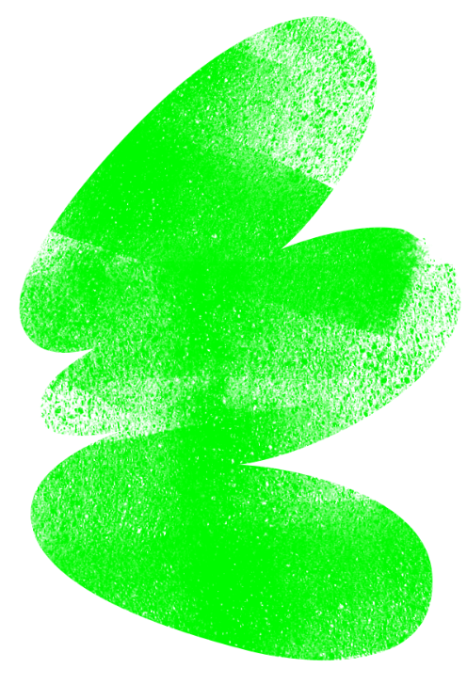
DESIGN
Main Page:
Main screen displaying the app name: "Productivito" with an attractive logo and tagline.
Onboarding Page:
A simple screen with an EditText for the user to enter their name and a Get Started button.
Dashboard:
Central hub with interactive buttons for the main features:
Pomodoro Timer
To-Do List
Habit Tracker
Daily Journal
Weekly Planner

Slide 8
DESIGN
Pomodoro Timer
UI Layout:
A countdown timer set to 25 minutes displayed prominently in the center.
Three buttons:
Start: Begins the timer countdown.
Pause: Pauses the timer.
Restart: Resets the timer to 25 minutes.
To-Do List
UI Layout:
Three input fields (EditTexts) for:
Task Name
Priority (e.g., High, Medium, Low)
Description
An Add Task button to save the task.
Data Representation:
Saved tasks displayed in a RecyclerView for easy scrolling and management.

Slide 9
DESIGN
Habit Tracker
UI Layout:
A central button labeled "Add New Habit".
On clicking the button:
An EditText appears for entering the habit name.
A progress tracker for the 21-day habit challenge displayed below.
Weekly Planner
UI Layout:
An Add Task button.
Upon clicking, the user enters:
Task Details: Task name, description.
Day of the Week: Dropdown menu or text input.
Data Representation:
Weekly tasks displayed in a table-like format with days as headers.

Slide 10

IMPLEMENTATION

Slide 11
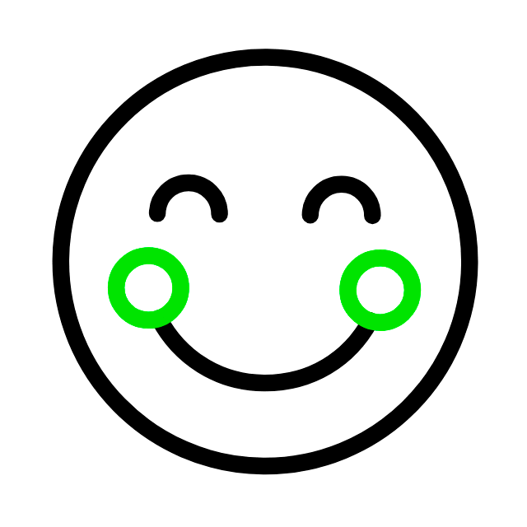

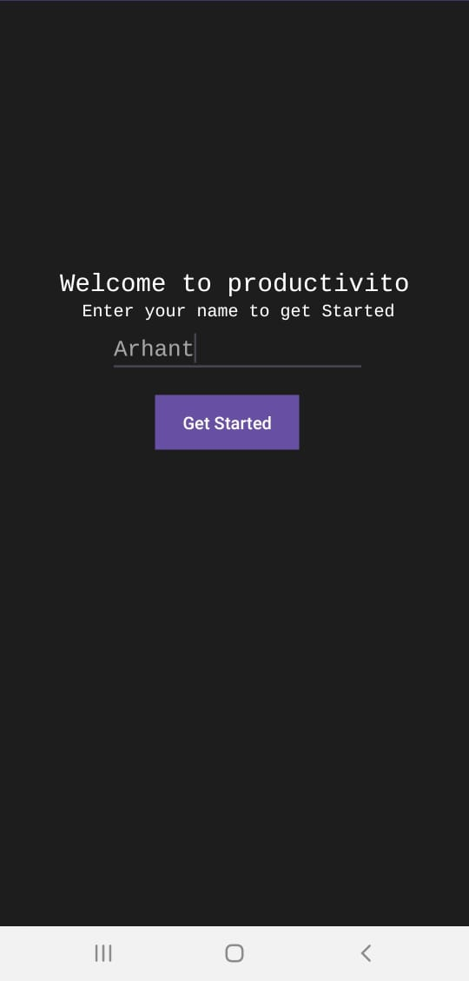

RESULTS
PRODUCTIVITO MAIN PAGE
WELCOME PAGE

Slide 12
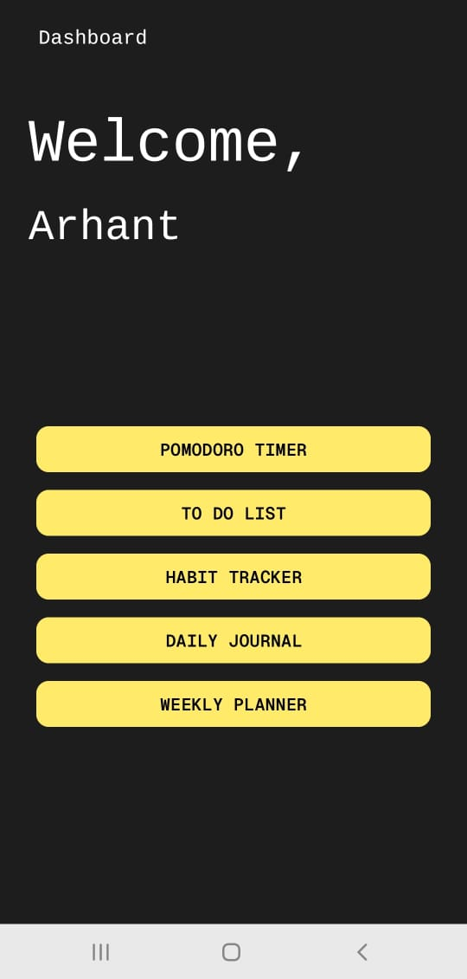
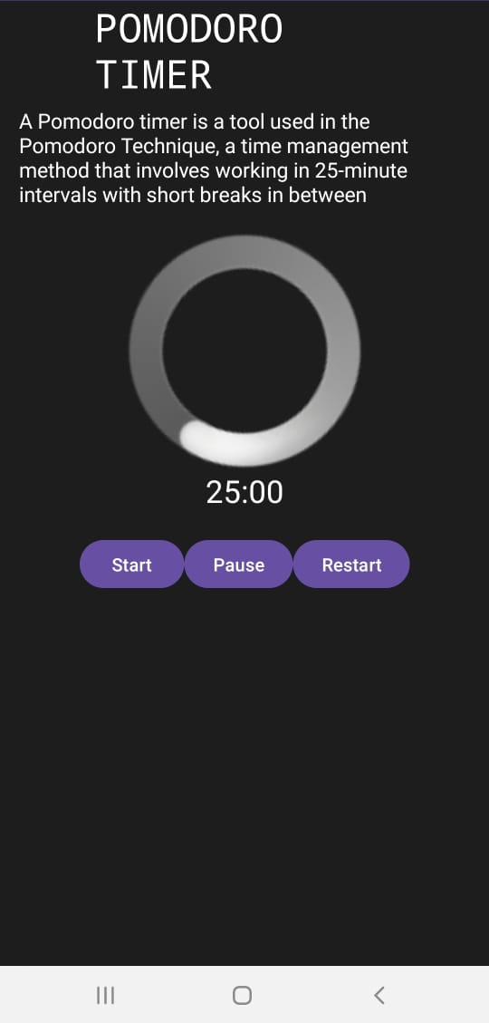
RESULTS
DASHBOARD
POMODORO TIMER

Slide 13
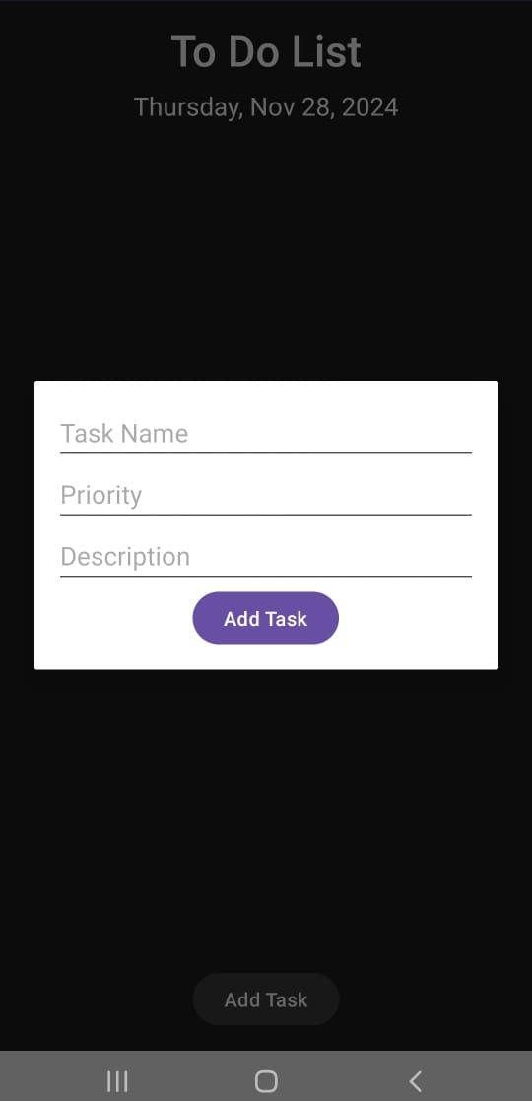
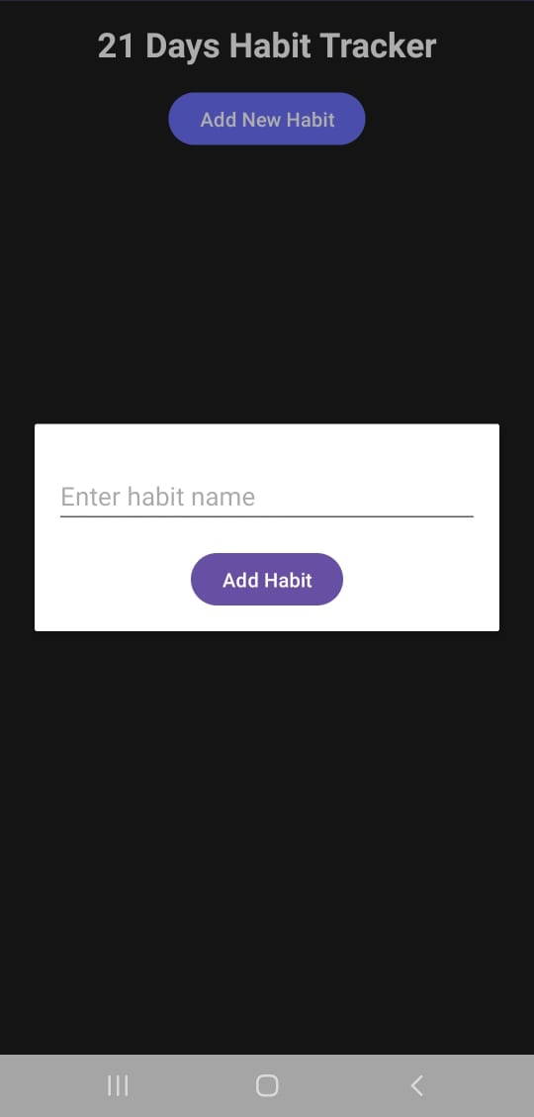
RESULTS
TO DO LIST
HABIT TRACKER

Slide 14
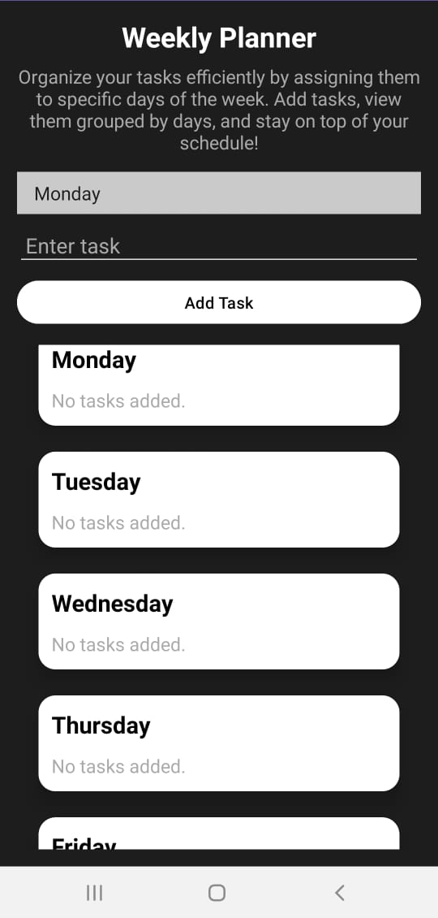
RESULTS
WEEKLY PLANNER

Slide 15
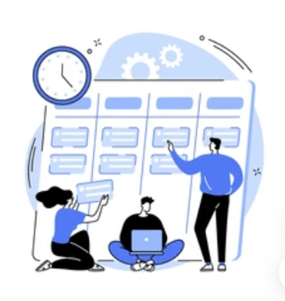
FUTURE SCOPE
Cloud Integration: Enable real-time data backup using cloud services like Firebase or AWS, ensuring secure and accessible data.
AI and Machine Learning: Incorporate AI to provide personalized recommendations for task prioritization, study schedules, and productivity tips.
Voice Commands: Enable users to add tasks, update progress, or set reminders using voice assistants like Siri, Alexa, or Google Assistant.

Slide 16
CONCLUSION
The productivity app is a simple and effective way to help students manage their time and stay organized. Its easy-to-use design and useful features make it a great tool for students to succeed in their studies. In the future, new updates can make the app even better and help more people, making it a must-have for students.

Slide 17
THANK YOU

